Slide 1
Web TECHNOLOGIES

Slide 2
Course Objectives
1
2
To understand what is web technology
To learn why web technology is needed
3
To Develop web applications

Slide 3
Course Outcomes
1
Construct a basic website using HTML and Cascading Style Sheets
2
Build dynamic web page with validation using Java Script objects and by applying different event handling mechanisms
3
Construct simple web pages in PHP
4
Develop interactive web applications

Slide 4

Reference Book
Reference Websites
W3schools
Javatpoint

Slide 5
Course Outline
Web Essentials
FRAMEWORK
Clients, Servers and Communication – The Internet – World wide web – HTTP vs HTTPS– Web Clients – Web Servers
Bootstrap Framework
HTML
JavaScript
DOM- Tables – Lists – Image – HTML control elements – Drag and Drop – Audio – Video controls
Will be provided later…
CSS
PhP
Inline, embedded and external style sheets – Rule cascading – Inheritance – Backgrounds – Border Images – Colors – Shadows – Text – Transformations – Transitions – Animations.
Will be provided later…

Slide 6
Web Essentials

Slide 7
WEB TECHNOLOGY
What is Web Technology?
Web Technology refers to the tools and techniques used for creating, managing, and maintaining websites and web applications.
About building and delivering content and services over the Internet

Slide 8

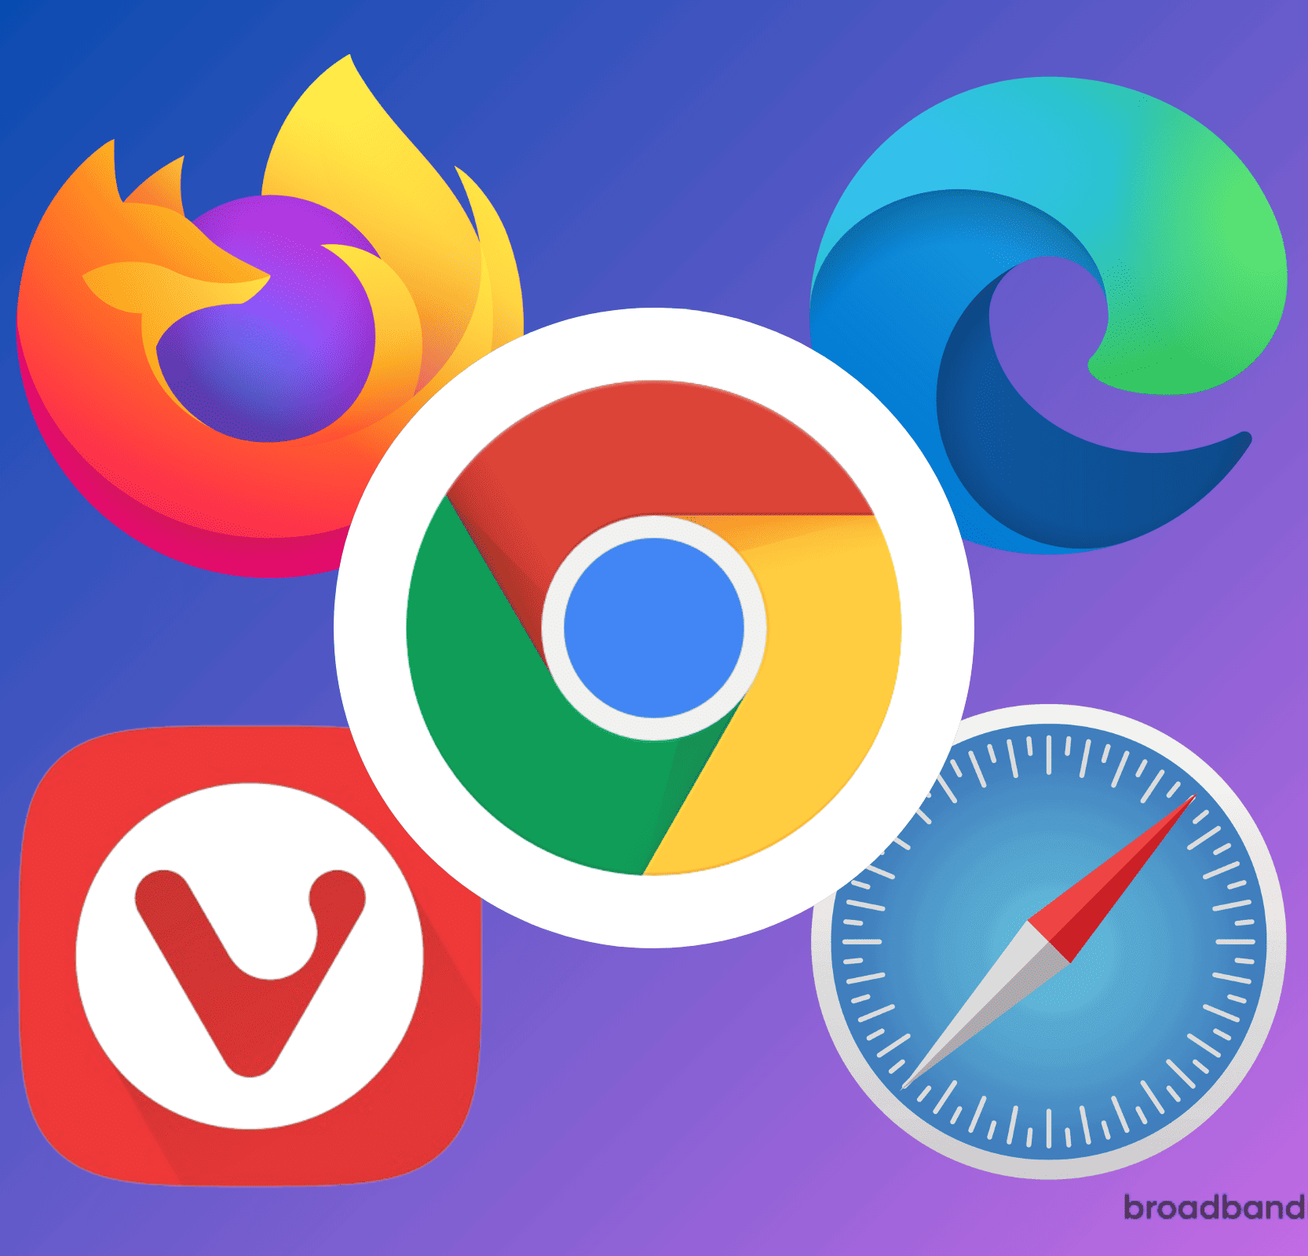




COMPONENTS
Web Servers
Web Browsers
HTML
Powerful computers that store and serve web content to users when requested.
Primary interface through which users access the internet.
Markup language used to structure and present content on the web.
CSS
JavaScript
PHP
Visual presentation of web content
Dynamic programming language that adds interactivity and functionality to web pages
General-purpose scripting language geared towards web development

Slide 9



ESSENTIAL TOOLS
Notepad++
VSCode
Xampp

Slide 10

C L I E N T S
What is a client?
The software that resides on the remote machine, communicates with the server, fetches the information, processes it, and then displays it on the remote machine is called the client.
-What is web client?

Slide 11
S E R V E R S
What is a server?
The software that distributes the information and the machine where the information and software reside is called the server
With the Internet, it's possible to access almost any information, communicate with anyone else in the world, and do much more
-What is web server?

Slide 12
S E R V E R S
What is a web client?
The client side (user side) of the Web.
A Web client typically refers to the Web browser in the user's machine or mobile device

Slide 13
S E R V E R S
What is a web server?
A web server is software and hardware that uses HTTP and other protocols to respond to client requests made over the World Wide Web.
Display website content through storing, processing and delivering webpages to users.

Slide 14
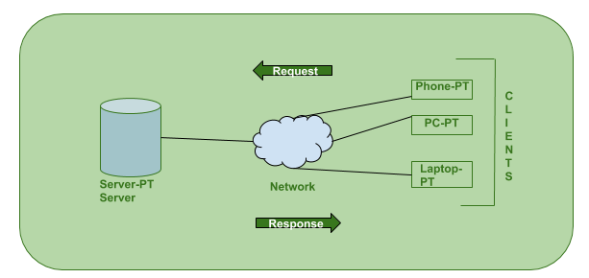
CLIENT
SERVER
COMMUICATION
Clients and servers exchange messages in a request response messaging pattern.
The client sends a request, and the server returns a response.
To communicate, the computers must have a common language, and they must follow rules so that both the client and the server know what to expect.

Slide 15
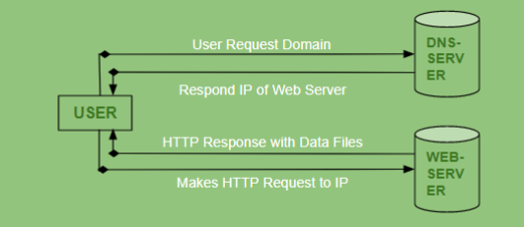
CLIENT
SERVER
COMMUICATION
User enters the URL(Uniform Resource Locator) of the website or file. The Browser then requests the DNS(DOMAIN NAME SYSTEM) Server.
DNS Server lookup for the address of the WEB Server.
DNS Server responds with the IP address of the WEB Server.
Browser sends over an HTTP/HTTPS request to WEB Server’s IP.
Server sends over the necessary files of the website.
Browser then renders the files and the website is displayed.

Slide 16
The Internet
It is the largest network in the world that connects hundreds of thousands of individual networks all over the world.
The popular term for the Internet is the “information highway”.
With the Internet, it's possible to access almost any information, communicate with anyone else in the world, and do much more.
Rather than moving through geographical space, it moves your ideas and information through cyberspace – the space of electronic movement of ideas and information.

Slide 17
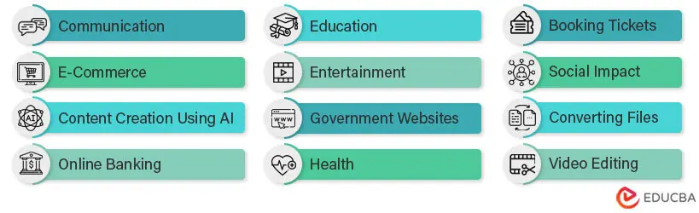
Uses of The Internet

Slide 18
WEB
The Web (World Wide Web) consists of information organized into Web pages containing text and graphic images.
It contains hypertext links, or highlighted keywords and images that lead to related information.
A collection of linked Web pages that has a common theme or focus is called a Web site.
The main page that all of the pages on a particular Web site are organized around and link back to is called the site’s home page.

Slide 19
Hypertext Mark-up Language (HTML)
HTML stands for Hyper Text Markup Language
HTML is the standard markup language for creating Web pages and describes the structure of a Web page
HTML consists of a series of elements (DOM)
HTML is made of tags (empty tag, container tag)

Slide 20
URL - OVERVIEW
A URL (Uniform Resource Locator) is a form of URI and standardized naming convention for addressing documents accessible over the Internet.
Below is additional information about each of the sections of the http URL for this page.
https://www.lus.ac.bd/academic/department-of-cse
https:// - Protocol
www - Subdomain
lus.ac.bd - Domain and domain sufix
academic - Directories
department-of-cse - Web Page

Slide 21
URL - http or https
The “http” stands for Hypertext Transfer Protocol.
It lets the browser to know which type of protocol it is going to use to access the information specified in the domain.
An “https” protocol is short for “Hypertext Transfer Protocol Secure” and indicates that information transmitted over HTTP is encrypted and secure.
After the http or https is the colon (:) and two forward slashes (//) that separate the protocol from the remainder of the URL.
A URL is not explicit to an HTTP or HTTPS addresses; FTP, TFTP, Telnet, and other addresses are also considered URLs and may not follow the same syntax as our example.

Slide 22
URL - www
www stands for World Wide Web and is used to distinguish the content.
This portion of the URL is not required and many times can be left out.
For example, typing https://www.lus.ac.bd/academic/department-of-cse would still get you to the website.
This portion of the address can also be substituted for an important sub page known as a subdomain.

Slide 23
URL - lus.ac.bd
lus.ac.bd is the domain name for the website.
The last portion of the domain is known as the domain suffix, or TLD.
It is used to identify the type or location of the website.
.bd is short for Bangladesh
There are several domain suffixes available. To get a domain, you would register the name through a domain registrar.

Slide 24
URL - academic
Academics - the directories where the web page is on the server.
To find the file on the server, it would be in the /public_html/academics directory.
With most servers, the public_html directory is the default directory containing the HTML files.

Slide 25
URL
Is an IP address the same as a URL or web address?
- No.
- An IP address is a unique number that's assigned to each device on a network.
- On the World Wide Web, a domain name is assigned a unique IP address.
- When typed (lus.ac.bd), DNS translates the domain name into an IP address that routers use to find the web server.
- A domain name is used instead of an IP address because it's easier for humans to remember.

Slide 26

Hyper Text
Transfer Protocol
The Hypertext Transfer Protocol (HTTP) is the foundation of the World Wide Web, and is used to load webpages using hypertext links.

Slide 27
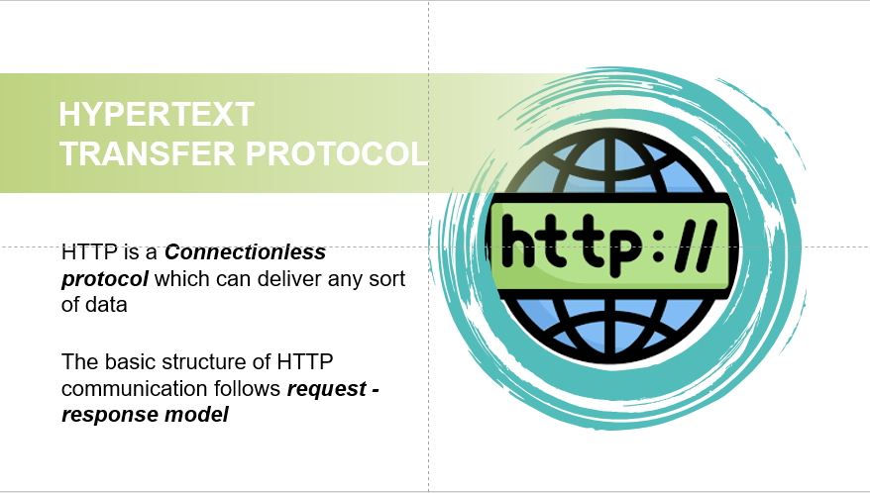

Slide 28
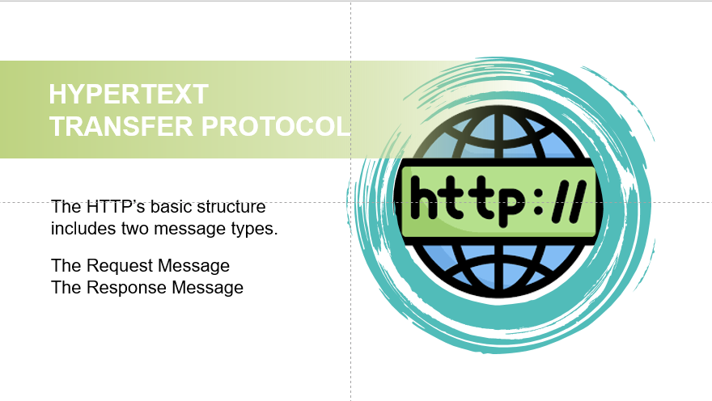

Slide 29
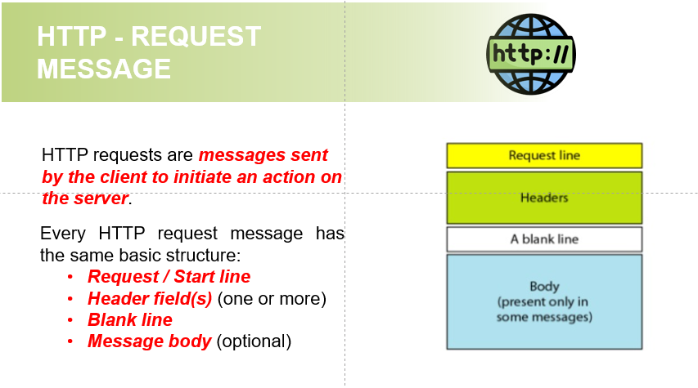

Slide 30
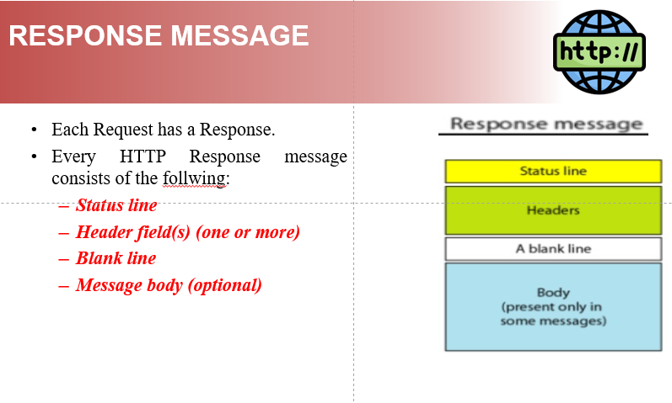

Slide 31


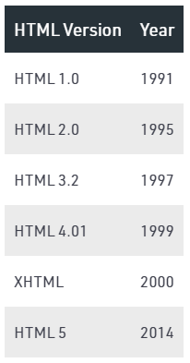
Hyper Text Mark-up Language
Skeleton of all web pages.
Provides structure to the content appearing on a website
Created by Tim Berners-Lee in 1991

Slide 32
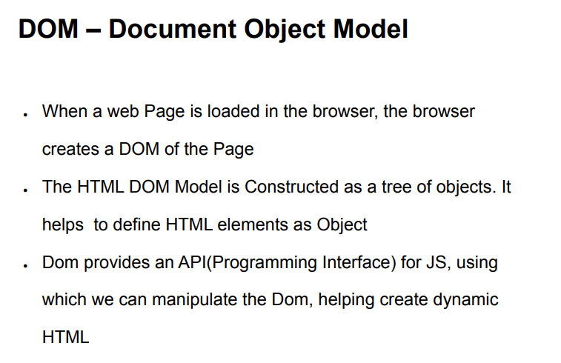
DOM

Slide 33
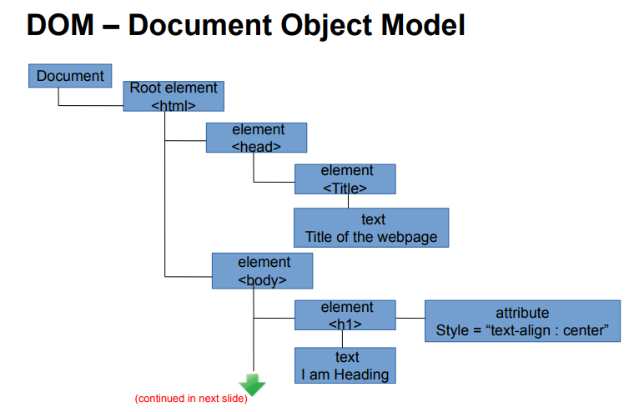
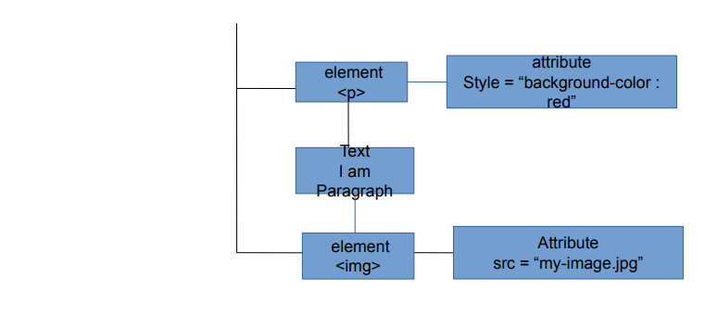

Slide 34
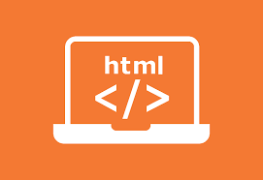
HTML - Structure
HTML is composed of elements that structure the webpage and define its content.
The elements are the building blocks of any HTML page and are represented by tags.
Tags are one of the most important part in an HTML Document.
HTML uses some predefined tags which tells the browser about content display property, that is how to display a particular given content.

Slide 35
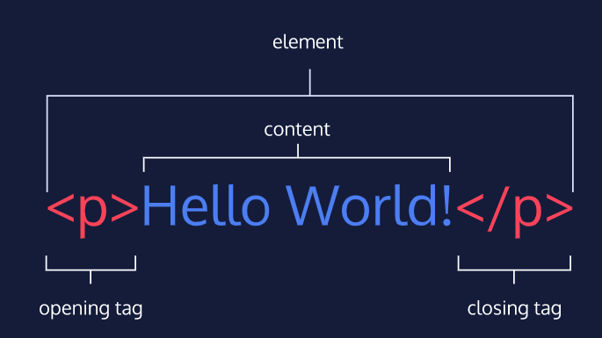
HTML - Structure
For Example, to create a paragraph, one must use the paragraph tags(<p> </p>) and to insert an image one must use the img tags(<img />)

Slide 36
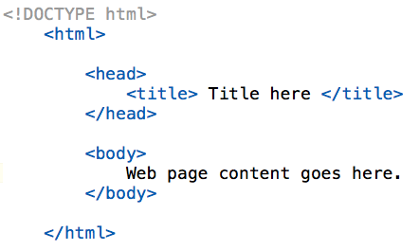
HTML - Structure
An HTML Document is mainly divided into two parts:
HEAD: This contains the information about the HTML document. For Example, Title of the page, version of HTML, Meta Data etc.
BODY: This contains everything you want to display on the Web Page.

Slide 37
HTML - Structure
Every Webpage must contain the above code.
<!DOCTYPE html>: This tag is used to tells the HTML version. This currently tells that the version is HTML 5.
<html>: This is called HTML root element and used to wrap all the code.
<head>: Head tag contains metadata, title, page CSS etc.
<body>: Body tag is used to enclosed all the data which a web page has from texts to links.
All of the content that you see rendered in the browser is contained within this element.

Slide 38
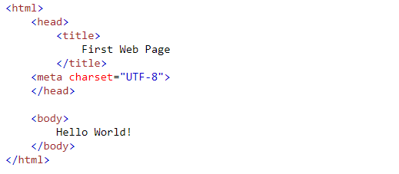
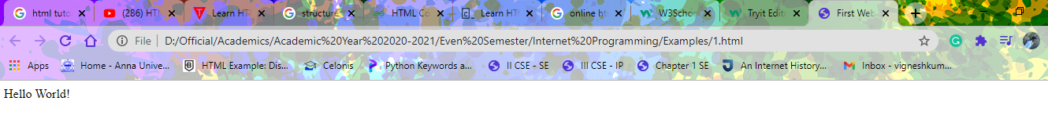
HTML – First Web Page
Example:
Output:

Slide 39
Basic HTML Tags & Attributes
The following tags help in organization and basic formatting of elements in our script or web pages.
HTML Paragraph <p> </p> - to write paragraph statements in a webpage.
Break </br> - to break line and acts as a carriage return.
Horizontal Rule <hr> - to break the page into various parts, creating horizontal margins
HTML Images <img src=”source_of_image“> - to insert an image into our web page
HTML Attributes - to provide extra or additional information about an element
HTML Comments - for inserting comments in the HTML code

Slide 40
Basic HTML Tags & Attributes
<html>
<head>
<!-- Example for Basic Tags -->
<title>Basic Tags</title>
<meta charset="UTF-8">
</head>
<body>
<h1>Tags and Usages</h1>
<p>
Computer Science Engineering (CSE) <br>is one of the popular domains among engineering aspirants which focuses on the basic elements
of computer programming.<br> </p>
<hr>
<img src="download.jpg">
</body>
</html>

Slide 41
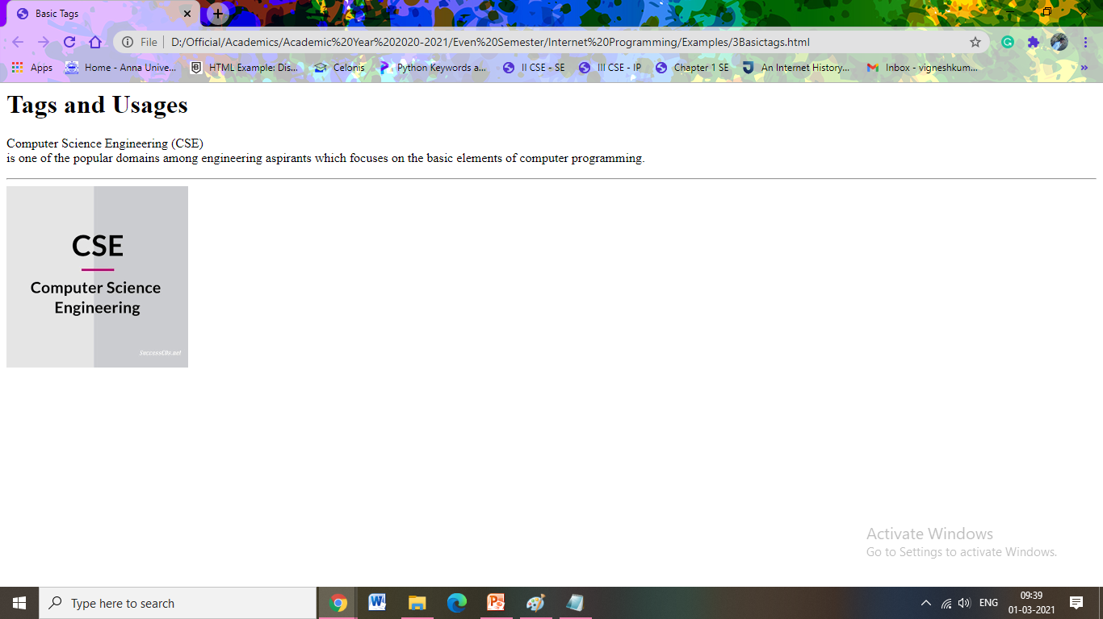
Basic HTML Tags & Attributes

Slide 42

Introduction to HTML5

Slide 43
History
1991
HTML first published
1995
HTML 2.0
After HTML 4.01 was released, focus shifted to XHTML and its stricter standards.
1997
HTML 3.2
XHTML 2.0 had very strict standards but was abandoned in 2009 in favor of HTML5.
1999
HTML 4.01
2000
XHTML 1.0
HTML5 is much more tolerant and can handle markup from all the prior versions. A working draft was released in 2012 and it is scheduled to be finalized by the end of 2014.
2002 -2009
XHTML 2.0
HTML continues to evolve, with ongoing developments and proposed features aiming to enhance its capabilities and address emerging needs. So far released versions are HTML5.2 in 2017, HTML5.3 in 2018.
2012
HTML5
2014
HTML5.1

Slide 44
FEATURES
Built-in audio and video support (without plugins)
Enhanced form controls and attributes
The Canvas (a way to draw directly on a web page)
Drag and Drop functionality
Support for CSS3 (the newer and more powerful version of CSS)
More advanced features for web developers, such as data storage and offline applications.

Slide 45
HTML5
<!DOCTYPE html>
<html lang="en">
<head>
<meta charset="utf-8">
<title>My First HTML5 Page</title>
<link rel="stylesheet" href="style.css">
</head>
<body>
<p>HTML5 is fun!</p>
</body>
</html>

Slide 46
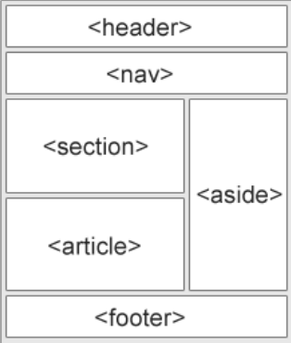
HTML 5 - Semantics
Semantic Tags: A semantic element clearly describes its meaning to both the browser and the developer.
HTML5 introduces many semantic elements which make the code easier to write and understand for the developer as well as instructs the browser on how to treat them.
A Semantic Web “allows data to be shared and reused across applications, enterprises, and communities."

Slide 47
HTML - Lists
A list is a record of short pieces of information, such as people’s names, usually written or printed with a single thing on each line and ordered in a way that makes a particular thing easy to find.
HTML offers three ways for specifying lists of information. All lists must contain one or more list elements.
An unordered list - ul
An ordered list – ol
dl,dt,dd

Slide 48
An Unordered Lists
An unordered list starts with the “ul” tag.
Each list item starts with the “li” tag.
The list items are marked with bullets i.e. small black circles by default.
The HTML Unordered List has various List Item Markers:-
Disc
Circle
Square
<ul style="list-style-type:disc/circle/square">

Slide 49
An Ordered Lists
An ordered list starts with the “ol” tag.
Each list item starts with the “li” tag.
The list items are marked with numbers by default.
The HTML Ordered List has various List Item Markers:
Items numbered with numbers
Items numbered with uppercase letters
Items numbered with lowercase letters
Items numbered with uppercase roman numbers
Items numbered with lowercase roman numbers
<ol type=“1” / “A” / “a” / “I” / “i”>

Slide 50
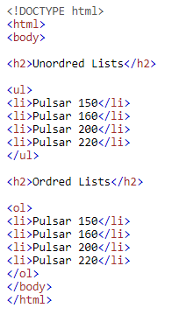
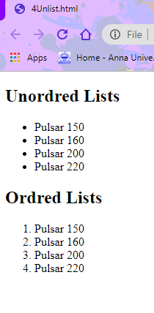
Lists Example
Code Output

Slide 51
HTML 5 - Header
The <header> tag in HTML is used to define the header for a document or a section.
Syntax:
The header tag contains information related to the title and heading of the related content.
The browsers which supports <header> tag are : Google Chrome 6.0, Internet Explorer 9.0, Firefox 4.0, Opera 11.1, Safari 5.0

Slide 52
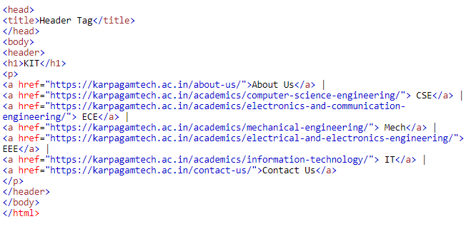
Header Example

Slide 53
HTML 5 - Footer
The <footer> element specifies a footer for a document or section.
A element should contain information about its containing element.
A footer typically contains the author of the document, copyright information, links to terms of use, contact information, etc.
Syntax:
<footer> ... </footer>

Slide 54
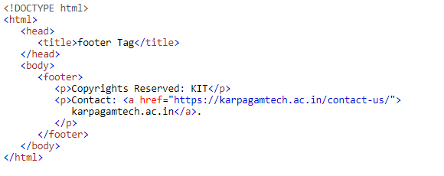
Footer - Example

Slide 55
HTML 5 - NAV
The <nav> element defines a set of navigation links.
Websites typically have sections dedicated to navigational links, which enables users to navigate the site.
These links can be placed inside a nav tag.
The links in the nav element may point to other webpages or to different sections of the same webpage.
Syntax:
<nav> Links </nav>

Slide 56
HTML 5 - Aside
The <aside> tag is used to describe the main object of the web page in a shorter way like a highlighter.
It basically identifies the content that is related to the primary content of the web page but does not constitute the main intent of the primary page.
The <aside> tag contains mainly author information, links, related content, and so on.
The <aside> tag makes it easy to design the page and it enhances the clarity of HTML document.
Syntax:
<aside>
<h1>Contents...</h1>
</aside>

Slide 57
HTML 5 - Article
The element specifies independent, self-contained content.
An article should make sense on its own, and it should be possible to read it independently from the rest of the web site.
Can be used for
Forum Post
Blog Post
Newspaper Article
Syntax
<article>
Contents
</article>

Slide 58
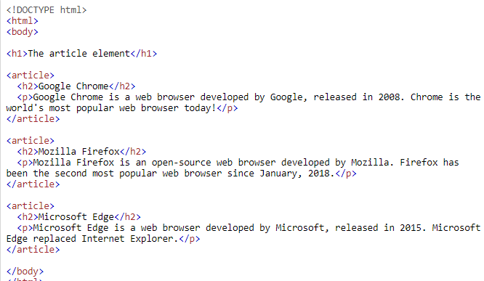
HTML 5 - Article

Slide 59
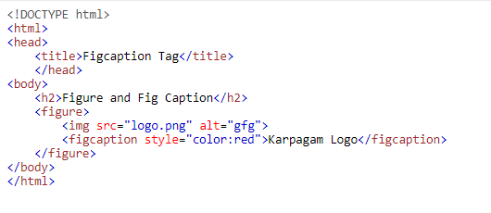
HTML 5 - FIGURE AND FIGCAPTION
These are used to add an image in a web page with small description.

Slide 60
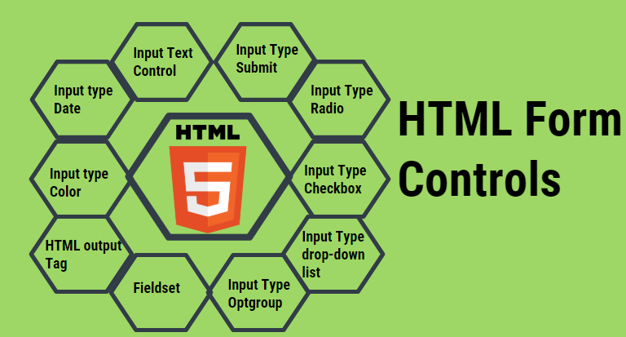
HTML 5 - Control Elements
HTML Control Elements are responsible to accept the User input in a specified manner.
These elements can be grouped together inside a form to collect data from a User in a User-friendly manner.

Slide 61
HTML 5 - Input Text Control
Input text controls are used to collect User data as a free text.
On the web page, it will form a rectangle box where Users can input the data.
There are different types of input text controls that can be used in the HTML forms.
Single line Input Text Control
Multi-line Input Text Control
Password Input Control

Slide 62
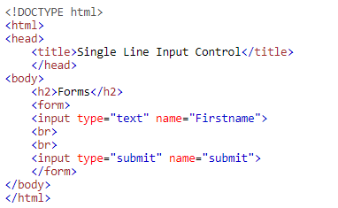
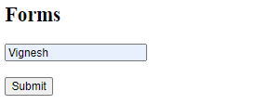
Single line Input Text Control
This allows the user to enter only a single line of data. A typical example of such input text controls is for entering the name, search box, city, etc.

Slide 63
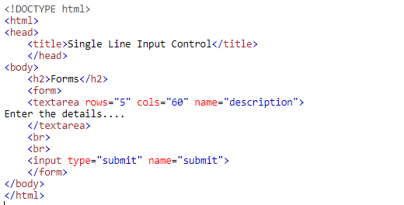
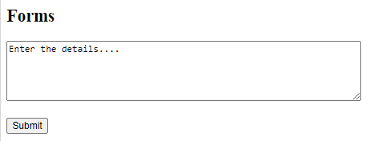
Multi-line Input Text Control
This input control type allows the user to enter data of multiple lines.
Typical usage of such input controls is for comments, addresses, description and so on.

Slide 64
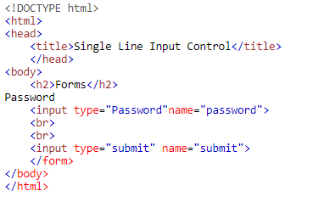
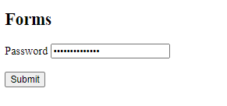
Password Input Control
This is typically used for the password field. This works in the same way as the input text field but the text gets masked for safety purposes.

Slide 65
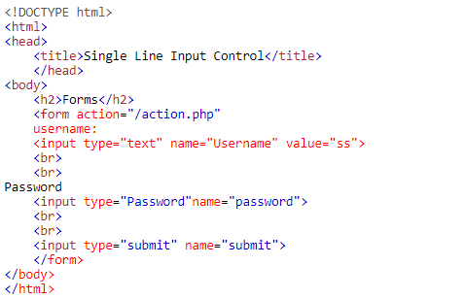
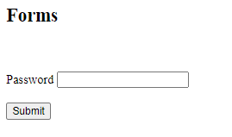
Input Type Submit
When input type is of submitting it performs the action defined in the form action and sends the form data to the server.

Slide 66
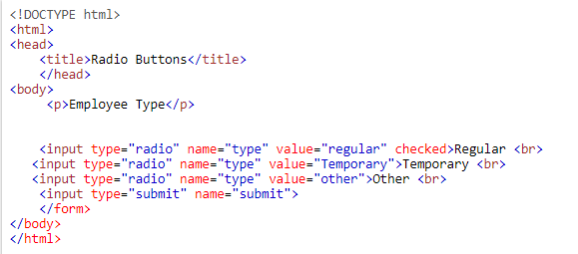
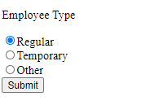
Input Type Radio
Radio buttons are used when you expect Users to fill data as a Boolean value or you expect only one input as true out of multiple options.

Slide 67
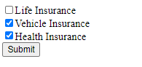
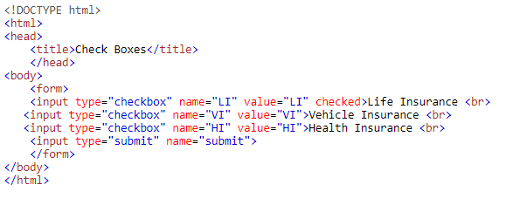
Input Type Checkbox
A checkbox lets the User select whatever information is true in his case.
It is a very convenient way of accepting the data when the possible input is already known.

Slide 68
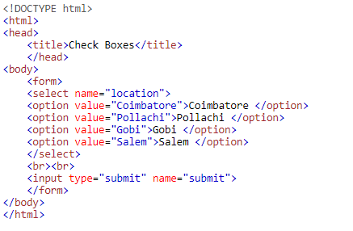
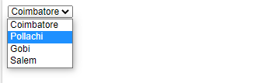
Input Type drop-down list
The drop-down list enables the user to select one option out of multiple possible options. This is a very User-friendly way to get the detail from the User as it provides an exhaustive list of possible options that helps the user to identify the option best suits him.

Slide 69
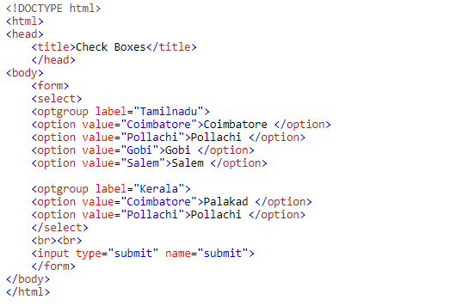
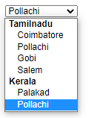
Input Type Optgroup
Optgroup works in a similar way as of the drop-down list, the only difference is that the optgroup lets you to logically group certain options under one umbrella. It helps the user to quickly identify the relevant option with the help of the optgroup label.

Slide 70
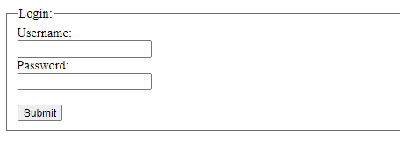
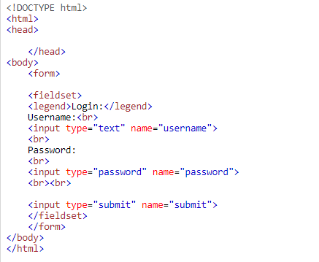
Fieldset
Fieldset is another useful tag in the Html form which let the developer to logically group certain controls under one legend, this help the developer to give User a clear instruction on what to expect in this section.

Slide 71
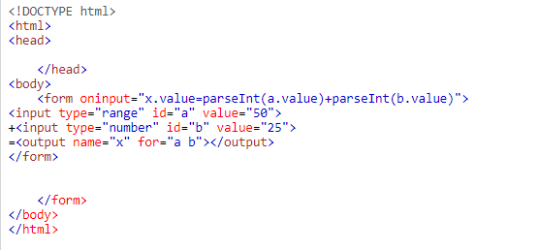
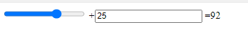
HTML output Tag
It let you display the output of a calculation instantly. This is quite useful when the user needs to do ay calculation instantly and see the results.

Slide 72
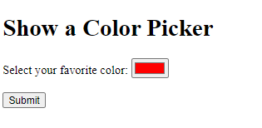
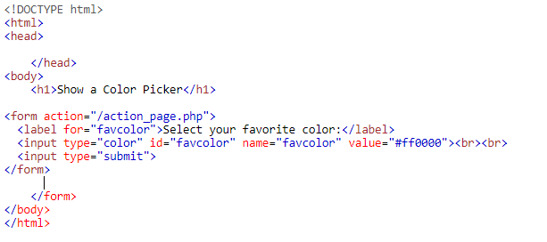
Input type Color
It is often required in the form to just show the color instead of any text.
It shows the color which you want to display in the form. Typical scenario’s where it is being used is to show the status of a project or a phase.

Slide 73
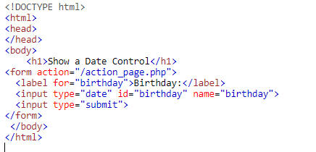
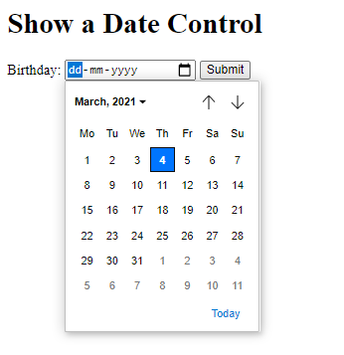
Input type Date
Input type date is commonly used where a date type field as input is expected by the User, it could be anything like a Date of Birth, Hiring date, termination date and so on.

Slide 74
HTML 5 Tables
The HTML table provides a way to derive or define the data such as text, images, links etc. in terms of rows and columns of cells.
The HTML tables can be created by using <table> tag.
The table can be created by using <th>, <td>, and <tr> tags.
The <th> tag defines a heading for the table.
The <td> tag specifies the table data cells which is used to make the column.
The <tr> tag specifies the table rows which is used to make a row.
The table data can be structured within <table>content of the table</table> with numerous table elements.

Slide 75


Basic Table Usage

Slide 76
Table Tags & Attributes
<caption> - caption for the table
cellspacing - specifies the space between table cells.
cellpadding - specifies the space between the border of a table cell and its contents.
Column and Row Span Attributes - The two or more table rows / columns can be merged into a single row / column.
bgcolor - background of the table
Height and Width of the Table - height and width of the table can be set by using width and height attributes
allign - provides the alignment of content inside an element

Slide 77

HTML 5 - Audio
The “audio” tag is an inline element that is used to embed sound files into a web page.
Attributes: The various attributes that can be used with the “audio” tag are listed below:
Controls: Designates what controls to display with the audio player.
Autoplay: Designates that the audio file will play immediately after it loads controls.
Loop: Designates that the audio file should continuously repeat.
src: Designates the URL of the audio file.
muted: Designates that the audio file should be muted.

Slide 78

HTML 5 - Video
The HTML5 “video” element specifies a standard way to embed a video in a web page.
There are three different formats that are commonly supported by web browsers – mp4, Ogg and WebM.
Attributes that can be used with the “video” tag are listed below :
Autoplay
Preload
Loop
Height and Width
Controls
Muted

